Slide 1
Stroke Prediction
Yue Yu, Jared C, Salem, Funmi Oluwasusi

Slide 2
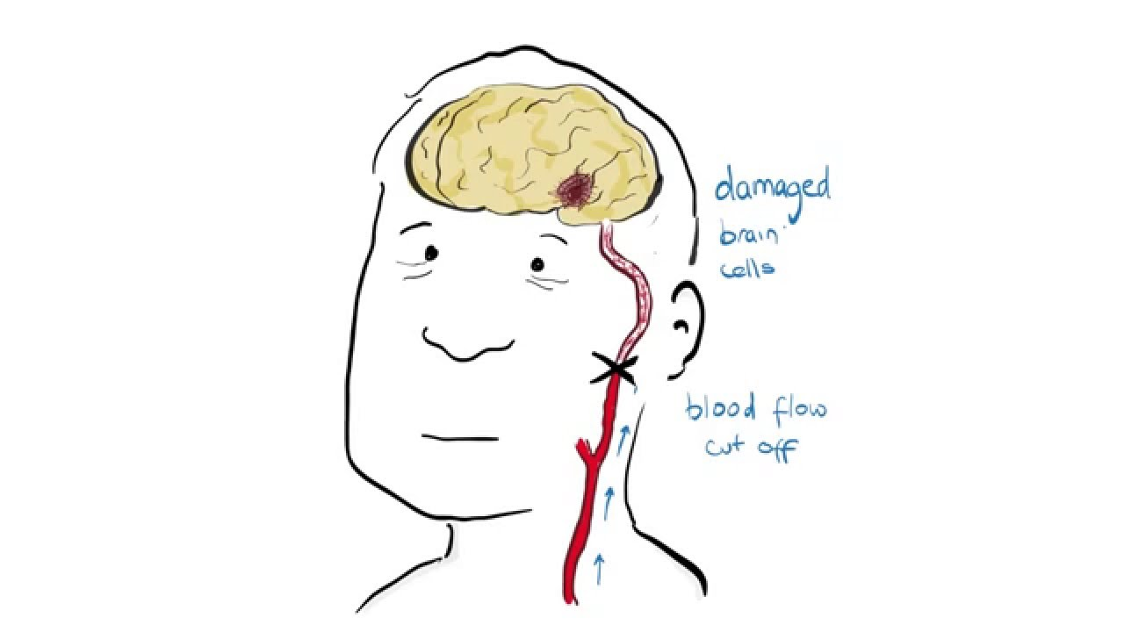
What is a stroke?
Medical emergency when a blood vessel clot or bursts
Prevent nutrients to brain -> brain cell dying
Lead to several living difficulties
2nd leading cause of death worldwide (according to WHO)
5th leading cause of death in the us

Slide 3
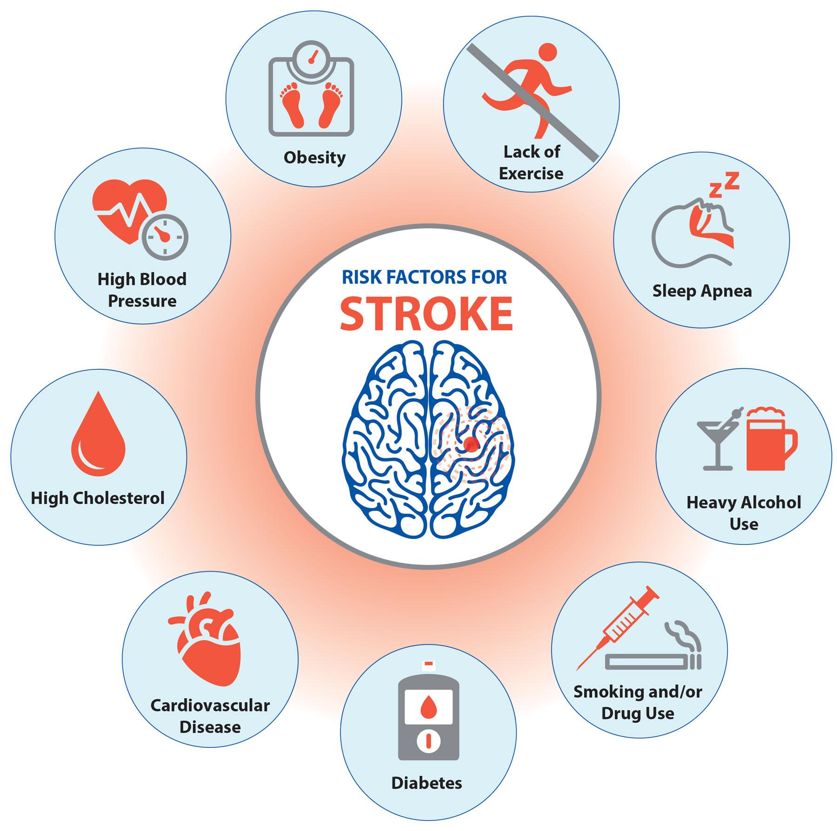
Major Risk Factors
Age
Gender
Hypertension
High Cholesterol
Smoking
Diabetes
Obesity
Stress

Slide 4
Data Used
Gender
Age
Hypertension
Heart Disease
Ever Married
Work Type
Residence Type
Average Glucose Level
BMI
Smoking status
Previous Stroke History

Slide 5
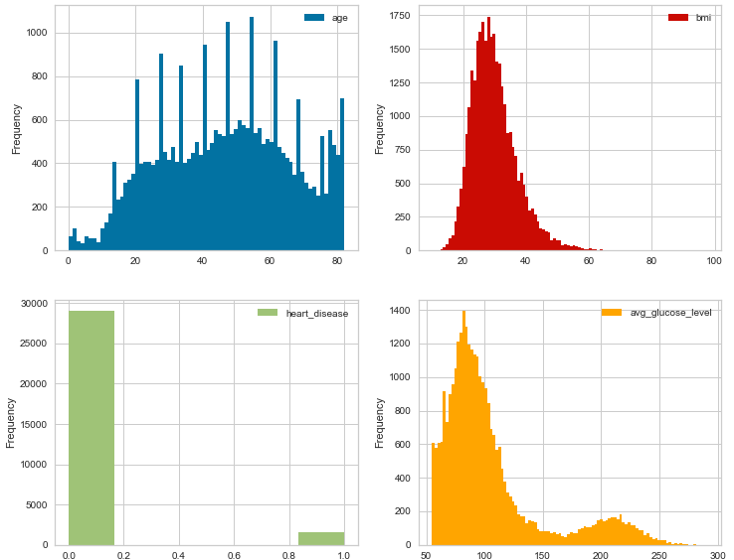
Variance Features Distribution

Slide 6
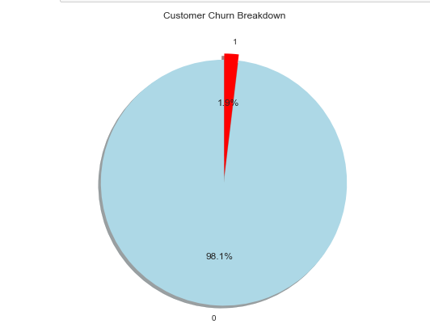
Stroke Pie Chart

Slide 7
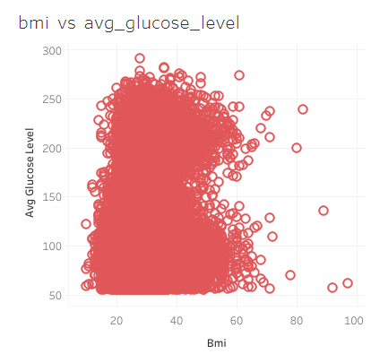
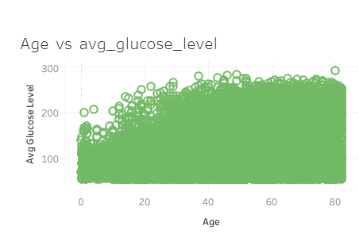
Correlation with Avg Glucose Level

Slide 8
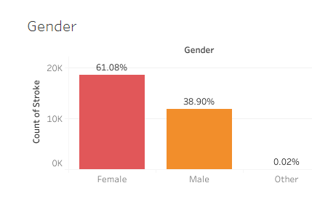
Gender

Slide 9
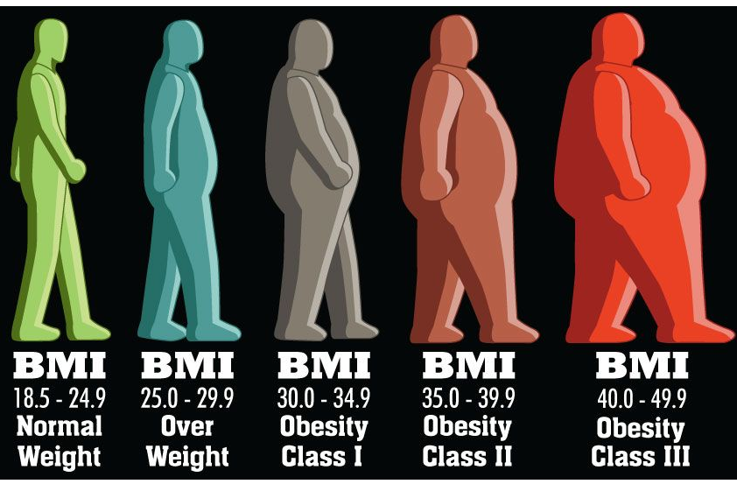
BMI

Slide 10
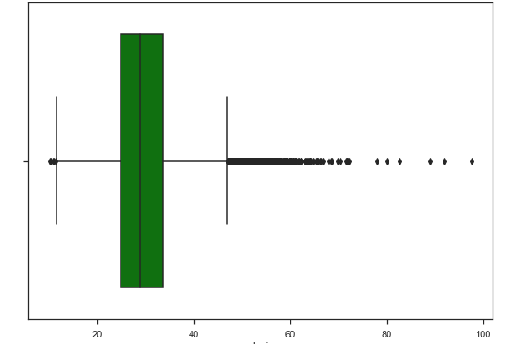
BMI Boxplot

Slide 11
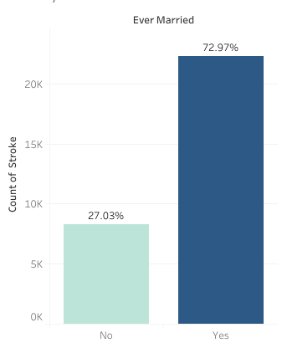
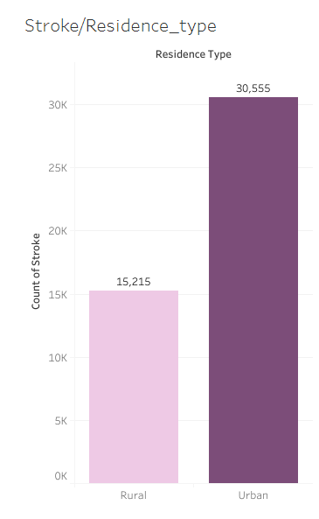
Stroke vs. Ever Married
Stroke vs. Residence Type

Slide 12
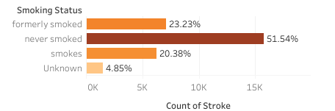
Stroke vs. Smoking Status

Slide 13
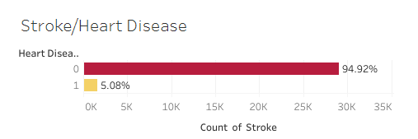
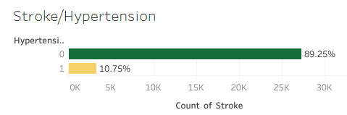
Stroke vs. Heart Disease
Stroke vs. Heart Disease

Slide 14


Classification Models
SVM
Random Forest Classifier

Slide 15
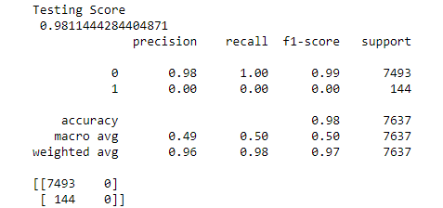
Classification Models
Logistic Regression

Slide 16
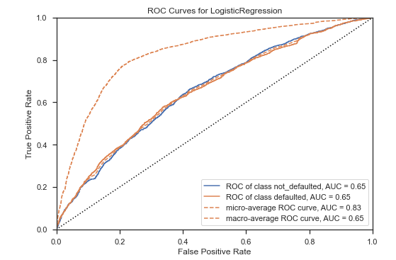
Classification Models
ROC Curves for Logistic Regression

Slide 17
Tools
GitHub
Python
Jupyter Notebook
PostgreSQL
Tableau
VSC

